Slide 1
Introduction to Machine Learning through Text Classification using Python
Nate Mahalingam
Crosby mba,2017

Slide 2
Structure
Who am I?
What is Machine Learning?
Deriving Logistic Regression and the Gradient Descent algorithm
Overview of Python
Running the actual code
Questions

Slide 3

Who am I?
First year Crosby MBA student focusing in Marketing Analytics
Born and raised in South India
Bachelor’s and Master’s in Chemical Engineering from the UK
Around 3 years of experience with Python
Major projects
Delivering the AP news on the Amazon Echo
Text classification for Sears
Notes:
Maybe add the video of the echo demonstration?

Slide 4
What is Machine Learning?
“Machine learning is the science of getting computers to act without being explicitly programmed”
What can we do with it?
Predict future sales based on current data
Netflix recommended movies
Google reverse image search
Self-driving cars
And many more…

Slide 5

Notes:
Keep or remove?
Need to skip through this

Slide 6
Types of Machine Learning
Supervised
Given a set of input variables and corresponding output variables, train the model using the set and predict the output for similar sets
Further classified into Regression and Classification problems
Examples: Linear Regression, Logistic Regression, Naïve Bayes, Support Vector Machine, Perceptron, Random Forest, etc.
Unsupervised
Given a set of inputs with NO outputs, find clusters and/or associations between the inputs
Further classified into Clustering and Association problems
Examples: K-means, Artificial Neural Networks, Principal Component Analysis, Singular Value Decomposition, etc
Notes:
Introduce a specific example that you are going to use to illustrate the concepts on this slides and all following slides. DONE
This could culminate with you showing them how you coded and implemented the example.

Slide 7
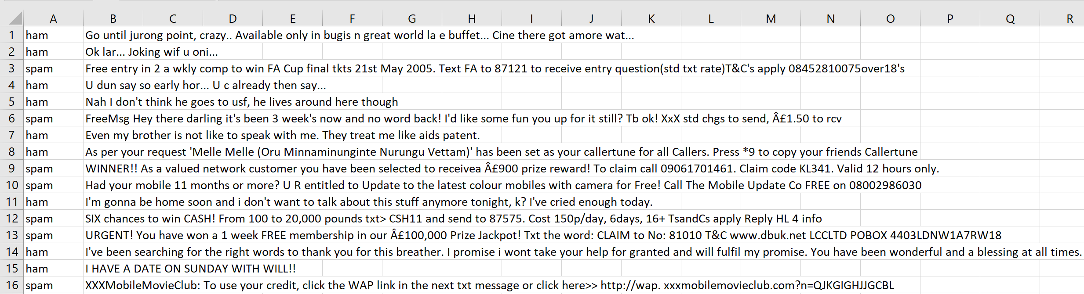
Our Problem
Given a set of text messages and an output that’s spam or not spam (ham), develop a classifier to predict whether a message is spam or ham

Slide 8
Our Model: Logistic Regression
Regression model that predicts the probability that an outcome will be a success or a failure.
Based on m independent variables or features
The output will always be binary

Slide 9

Training Set
Text messages
Learning Algorithm
Logistic Regression
Document-Term Matrix
Logistic Function
$$h$$
Spam or Ham
X
y
Notes:
What is a function of training set in your example. How large should it be?
What is the algorithm leaning in your specific example?
TODO: Change this flowchart DONE

Slide 10
hϴ represents the PROBABILITY that the output will be a SUCCESS

Slide 11
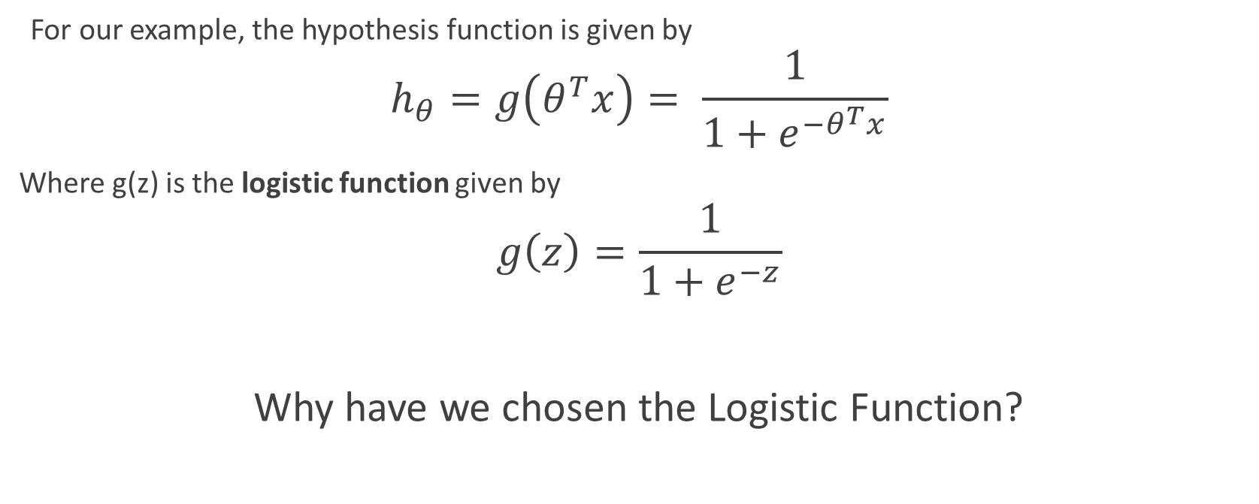

Logistic Regression
For our example, the hypothesis function is given by
$$h_{θ}=g\left(θ^{T}x\right)= \frac{1}{1+e^{−θ^{T}x}}$$
Where g(z) is the logistic function given by
$$g\left(z\right)=\frac{1}{1+e^{−z}}$$
Why have we chosen the Logistic Function?
$$θ_{0}+θ_{1}x_{1}+⋯+θ_{n}x_{n}$$
Notes:
Show the logistic function sigmoid shape now
Lies between 0 and 1 which is convenient for us

Slide 12
Our Goal
Find the best combination of the input features using the best possible feature weights θ
Notes:
Write out the 1/(1+exp-(b0+b1x1+b2x2+…+bnxn))
Explain how it can be represented as a vector
TODO: Add slide to introduce the problem before this DONE

Slide 13
Our Strategy
We will MAXIMIZE the PROBABILITY of the output being a certain value given the set of inputs

Slide 14
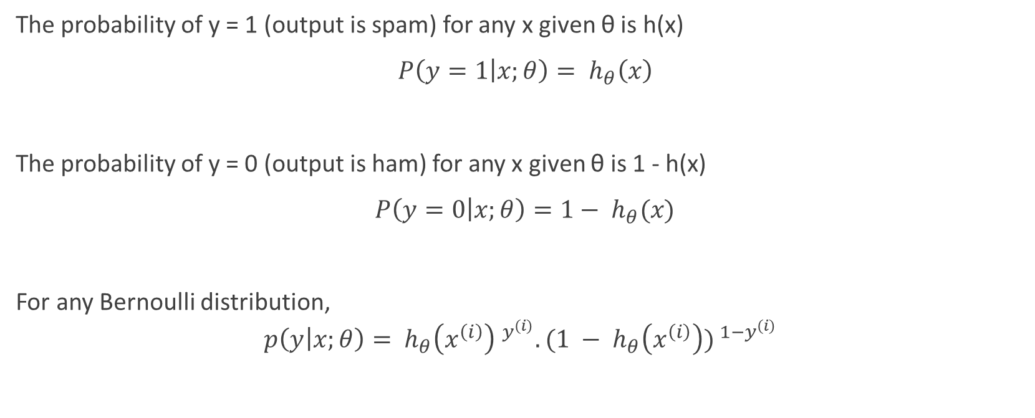
Bernoulli Distribution
The probability of y = 1 (output is spam) for any x given θ is h(x)
$P\left(y=1 | x;θ\right)= h_{θ}\left(x\right)$
The probability of y = 0 (output is ham) for any x given θ is 1 - h(x)
$P\left(y=0 | x;θ\right)=1− h_{θ}(x)$
For any Bernoulli distribution,
$$p\left(y | x;θ\right)= {h_{θ}\left(x^{\left(i\right)}\right) }^{y^{\left(i\right)}}.({{1 − h}_{θ}\left(x^{\left(i\right)}\right)) }^{{1−y}^{\left(i\right)}}$$
Notes:
It might be useful to re-write this in terms of your example, i.e. substitute success with the specific outcome of interest; substitute x with the appropriate variable from your example.
========
The probability of y =1 for any x given theta is h(x); The probability of y =0 for any x given theta is 1-h(x)
The notation “p(y(i)|x(i); θ)” indicates that this is the distribution of y(i) given x(i) and parameterized by θ. p(y|x; θ), the conditional distribution of y given x
Consider logistic regression, where the probability p(y = 1|x; θ) is modeled by hθ(x) = g(θT x). We would then predict “1” on an input x if and only if hθ(x) ≥ 0.5, or equivalently, if and only if θT x ≥ 0. Consider a positive training example (y = 1). The larger θT x is, the larger also is hθ(x) = p(y = 1|x; w, b), and thus also the higher our degree of “confidence” that the label is 1. Thus, informally we can think of our prediction as being a very confident one that y = 1 if θT x ≫ 0. Similarly, we think of logistic regression as making a very confident prediction of y = 0, if θT x ≪ 0. Given a training set, again informally it seems that we’d have found a good fit to the training data if we can find θ so that θT x(i) ≫ 0 whenever y(i) = 1, and θT x(i) ≪ 0 whenever y(i) = 0, since this would reflect a very confident (and correct) set of classifications for all the training examples. This seems to be a nice goal to aim for, and we’ll soon formalize this idea using the notion of functional margins

Slide 15

Likelihood Function
Define the Likelihood function L(θ)
$$ℒ\left(θ\right)= \prod_{i=1}^{m}{{h_{θ}\left(x^{\left(i\right)}\right) }^{y^{\left(i\right)}}.({{1 − h}_{θ}\left(x^{\left(i\right)}\right)) }^{{1−y}^{\left(i\right)}}}$$
What does this represent?
Notes:
Given X (the design matrix, which contains all the x(i)’s) and θ, what is the distribution of the y(i)’s? The probability of the data is given by p(~y|X; θ). This quantity is typically viewed a function of ~y (and perhaps X), for a fixed value of θ. When we wish to explicitly view this as a function of θ, we will instead call it the likelihood function
Likelihood is used after data are available to describe a function of a parameter (or parameter vector) for a given outcome.

Slide 16
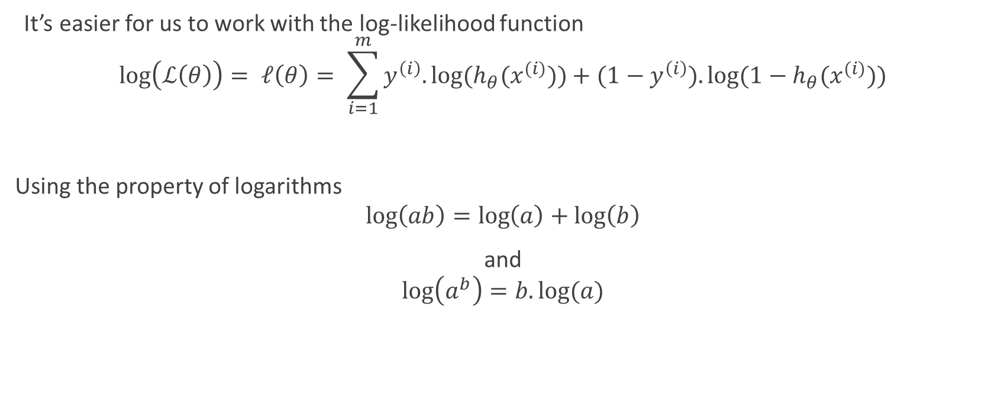
Log-Likelihood Function
It’s easier for us to work with the log-likelihood function
$$\log\left(ℒ\left(θ\right)\right)= ℓ\left(θ\right)= \sum_{i=1}^{m}{y^{\left(i\right)}.log⁡(h_{θ}(x^{(i)}))}+{(1−y}^{\left(i\right)}).log⁡({1−h}_{θ}(x^{(i)}))$$
Using the property of logarithms
$$\log\left(ab\right)=\log\left(a\right)+\log\left(b\right)$$
and
$$\log\left(a^{b}\right)=b.log⁡(a)$$

Slide 17

The Update Rule
$θ_{j}≔θ_{j}+ α\frac{∂}{∂θ_{j}}ℓ\left(θ\right)$
Learning rate
Maximum log-likelihood

Slide 18



Maximizing the Log-Likelihood
$$\frac{∂}{∂θ_{j}}ℓ\left(θ\right)=\frac{∂}{∂θ_{j}}\left(\sum_{i=1}^{m}{y^{\left(i\right)}.log⁡(h_{θ}(x^{(i)}))}+{(1−y}^{\left(i\right)}).log⁡({1−h}_{θ}(x^{(i)})) \right)$$
$$=\left(y\frac{1}{g(θ^{T}x)} −\left(1−y\right) . \frac{1}{1−g(θ^{T}x)} \right).\frac{∂}{∂θ_{j}}g(θ^{T}x)$$
$$=\left(y\frac{1}{g\left(θ^{T}x\right)} −\left(1−y\right) . \frac{1}{1−g\left(θ^{T}x\right)} \right).g\left(θ^{T}x\right)\left(1−g\left(θ^{T}x\right)\right).\frac{∂}{∂θ_{j}}(θ^{T}x)$$
$$=\left(y .\left(1−g\left(θ^{T}x\right)\right)−(\left(1−y\right)g\left(θ^{T}x\right)\right)x_{j}$$
$$\frac{∂}{∂θ_{j}}ℓ\left(θ\right)=(y−h_{θ}\left(x\right))x_{j}$$
$$g^{′}\left(z\right)=g\left(z\right).(1−g\left(z\right))$$
$$\frac{d}{dz}\frac{1}{1+e^{−z}}=\frac{1}{{\left(1+e^{−z}\right)}^{2}}\left(e^{−z}\right)$$
$=\frac{1}{1+e^{−z}} \left(1 −\frac{1}{1+e^{−z}}\right)$
= $g\left(z\right).(1−g\left(z\right))$
Notes:
How do existing packages allow you to work with this? Pre-packaged initial code, etc…

Slide 19
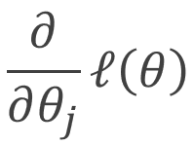
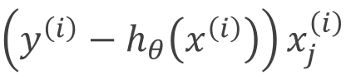


The Stochastic Gradient Ascent Algorithm
Loop {
for i = 1 to m {
$θ_{j}≔θ_{j}+ α$
}
}
Notes:
$$θ := θ − H^{−1}∇_{θ}ℓ\left(θ\right)$$
$$H_{ij}= \frac{∂^{2}ℓ\left(θ\right)}{∂θ_{i}∂θ_{j}}$$
H = Hessian Matrix

Slide 20
A QUICK DEMONSTRATION OF THIS RULE
Notes:
Show the gradient descent steps in python

Slide 21
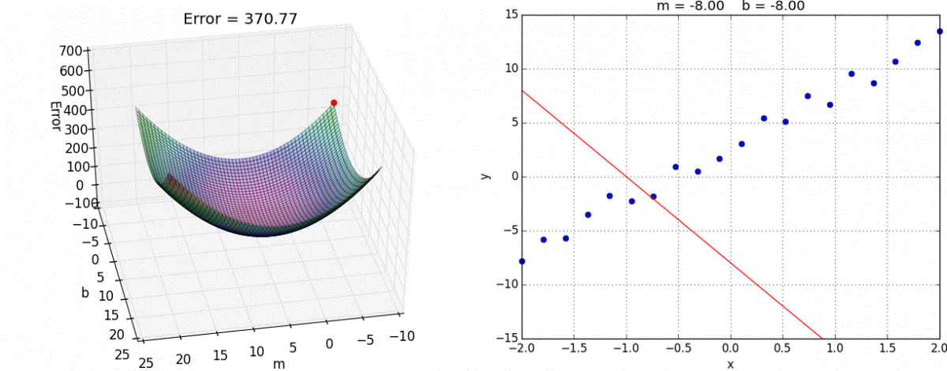
LINEAR Regression using Gradient DESCENT
Notes:
Give it a title; label axes based on example
Remove or not? Could create a gradient ascent animation if I can understand the code in time
This should animate

Slide 22
Used for binomial classification
By
Maximizing the likelihood of the output
Through
Stochastic Gradient Ascent Rule
Logistic Regression
Predict
Determine the best combination of features
Output through trained parameters for the features
Determine the parameters of the features

Slide 23
Python
Created in 1991 by Guido van Rossum
Emphasizes readability and simplicity over complexity
“Simple is better than complex.”
Software that use Python
Dropbox
BitTorrent
Yahoo Mail started out as 411 mail which was all Python
Google's first crawler was written in Python
And many more
Syntactic sugar
Notes:
Need to improve this

Slide 24
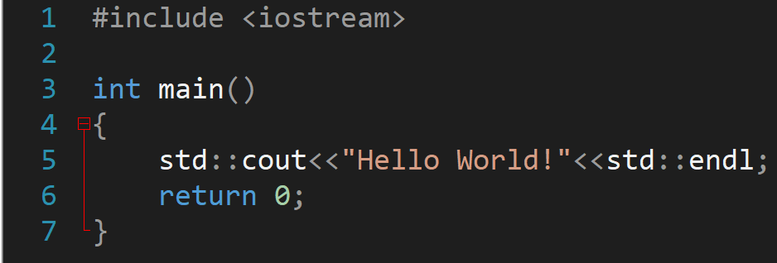
Syntactic Sugar
Header file
Preprocessor statement
Namespace std
Brackets
Function declaration
Overloaded bitwise shift operator
Normal exit status
Semicolons

Slide 25
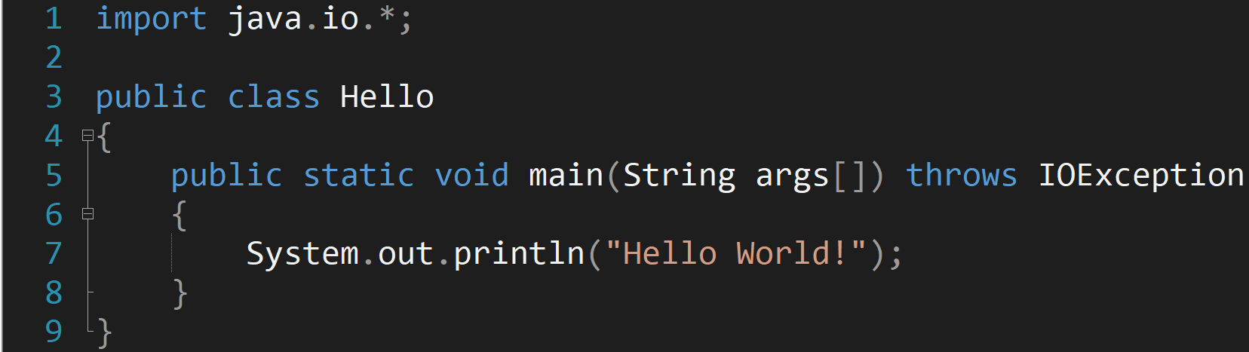
Import everything from java.io package
Class declaration
Main function declaration
Print function
Semicolons
Even more brackets

Slide 27






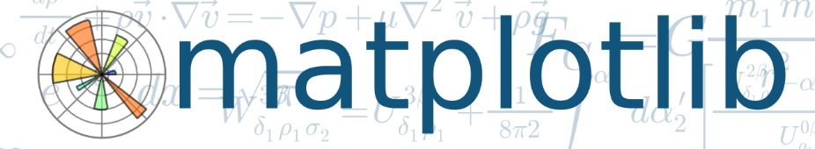
Packages needed
NLTK

Slide 28
Time to run the actual code!
Notes:
Switch to jupyter notebook

Slide 29
Questions

